Slide 1
GROUP-5 INTRODUCTION TITLE: WINE AND TITANIC DATASET
Group Member: -Hridaya Manandhar
-Pramisha Giri

Slide 2
Project Objective
Predict wine quality using machine learning techniques.
Analyze the dataset to understand important features.
Evaluate different models for performance and accuracy

Slide 3
Wine Dataset Overview
1,143 rows and 13 columns.
No missing values.
Mostly numerical data.
Target variable: quality (score from 0 to 10).

Slide 4
Exploratory Data Analysis (EDA)
Content:
Used .info() and .describe() to understand data types and statistics.
No nulls – clean dataset.
All features are numeric, ideal for ML algorithms.
Outlier detection and Handling
Feature Engineering
Feature Scaling
Visualization

Slide 5
Training, Testing, Interference
Model Selection
Support Vector Regression (SVR)
Linear Regression
Random Forest Regressor
Ridge Regression
Support Vector Regression

Slide 6
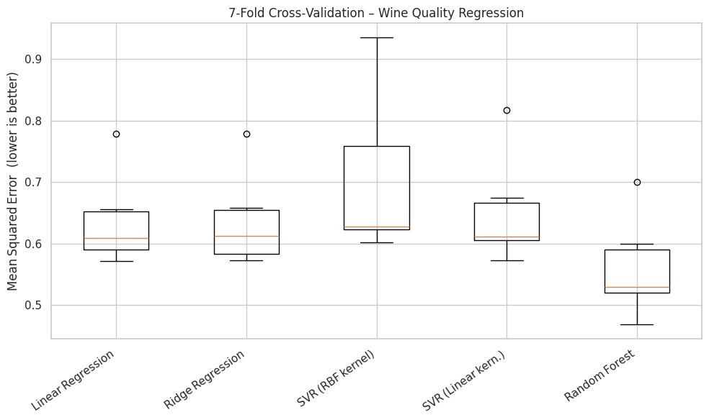
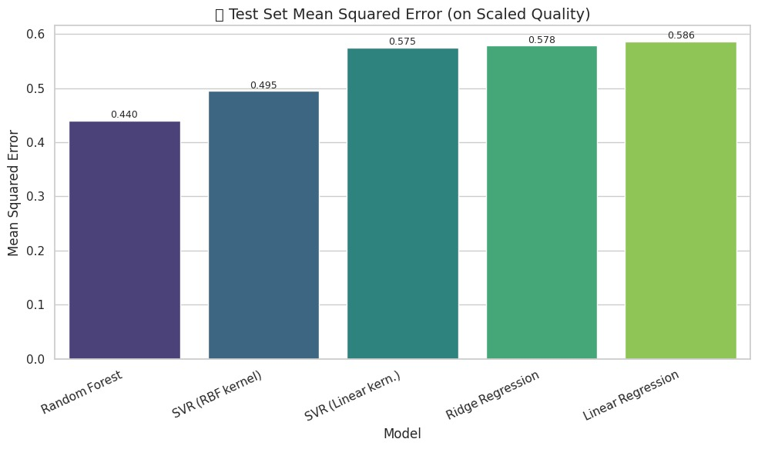
Training, Testing, Interference
Model Selection
Support Vector Regression (SVR)
Linear Regression
Random Forest Regressor
Ridge Regression
Support Vector Regression
Model Accuracy
Mean squared error (MSE)

Slide 7
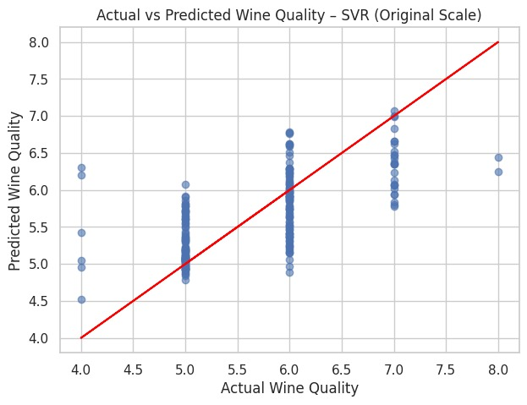
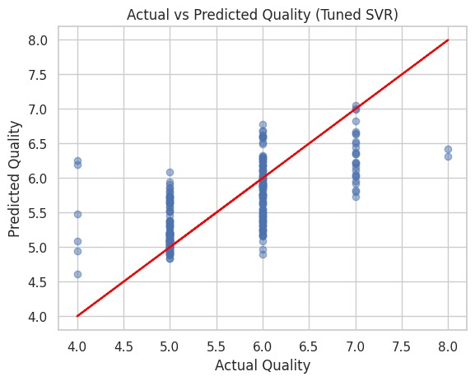
Baseline Model
Tuning Hyperparameters

Slide 8
CLASSIFICATION MODEL TITANIC DATASET
Objective: Predict survival on the Titanic using classification models.
Dataset: Titanic dataset from Kaggle
Key Steps:
Exploratory Data Analysis (EDA)
Data Preprocessing
Model Building & Evaluation
Hyperparameter Tuning
Inference on Test Data

Slide 9
Exploratory Data Analysis
Checked for null values (e.g., in 'Age', 'Cabin', 'Embarked’)
5 rows and 27 columns
Visualizations:
Survival counts (bar plot)
Age distribution (histogram)
Survival by gender (bar plot)
Correlation heatmap
Insights:
Females had higher survival rates
Children and 1st class passengers more likely to survive

Slide 10
Data Preprocessing
Dropped irrelevant columns: Cabin, Ticket, Name, PassengerId
Imputed missing values:
Age: median
Embarked: most frequent
Converted categorical to numeric using:
LabelEncoder or get_dummies
Feature scaling using StandardScaler

Slide 11
Model Selection And Training
Models used:
Logistic Regression
K-Nearest Neighbors (KNN)
Decision Tree Classifier
Random Forest Classifier
Support Vector Machine (SVM)
Split data: Train (80%) / Test (20%)
Evaluated using accuracy, confusion matrix

Slide 12
Hyperparameter Tuning
Used GridSearchCV on:
Random Forest (e.g., n_estimators, max_depth)
SVM (C, gamma, kernel)
Best models:
Random Forest performed the best after tuning
Cross-validation improved model reliability

Slide 13
Inference and Results
Final model inference on test data
Predictions stored and submitted in CSV format
Conclusion:
Effective pipeline from EDA to prediction
Feature selection and tuning significantly improved performance
Balanced use of visualization and ML techniques

